Slide 1
REAL TIME MAPPING OF EPIDEMIC SPREAD
PIP2001 Capstone Project
Review-0
Batch Number: CSE-15
Roll Number : | Student Name :
20211CSE0218 | Sadiya Mohammedi
20211CSE0835 | Aakif Mohamed Nadeem
20211CSE0333 | Mrinal Raj
20211CSE0713 | Faizeen Shezan
Under the Supervision of,
Ms. Alina Raheen
Assistant Professor
School of Computer Science and Engineering
Presidency University
Name of the Program: CSE
Name of the HoD: Dr.Asif Mohammed H.B
Name of the Program Project Coordinator: Mr. Amarnath J.L & Dr. Jayanthi. K.
Name of the School Project Coordinators: Dr. Sampath A K

Slide 2
Content
Problem Statement
Github Link
Analysis of Problem Statement
Timeline of the Project
References

Slide 3
Problem Statement Number:
Organization: Thermo Fisher
Category (Hardware / Software / Both) :Software
Problem Description : We envision a simple portal which shall provide real time data on how an epidemic is and can spread. Real time status and alerts will be the primary objective of this project. To achieve this objective, we will need to build layers of crowd sourced data that will add up to provide rich real time status of an epidemic spread as it happens.
Difficulty Level: Complex

Slide 4
Github Link
Github Link :
saad751/Real-time-mapping-of-epidemic-spread (github.com)

Slide 5
Analysis of Problem Statement
Technology Stack Components:
Frontend: HTML5, CSS3, JavaScript (React/Angular/Vue)
Backend: Java with MySQL
Machine Learning: Implemented in Jupyter Notebooks for analysis, clustering, and time-series forecasting
APIs: For real-time data integration and mapping

Slide 6
Analysis of Problem Statement (contd...)
Software and Hardware Requirements:
Hardware :
Processor - I3/Intel Processor
Hard Disk -160GB
Key Board - Standard Windows Keyboard
Mouse - Two or Three Button Mouse
Monitor - SVGA
RAM - 4Gb
Software :
Operating System – Windows 7/8/10
Server side Script : Python, Java, HTML, MYSQL, CSS, Bootstrap.
Libraries : PANDAS, Flask, Smtlib
IDE : Jupyter Notebook

Slide 7
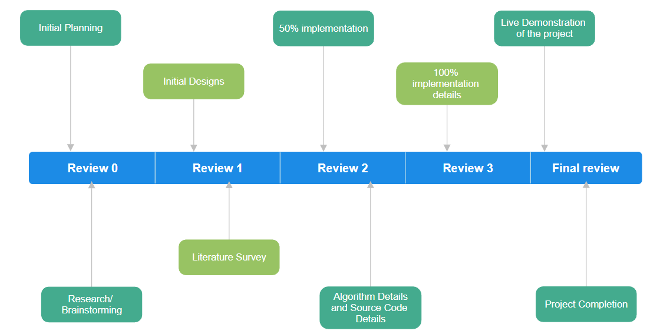
Timeline of the Project (Gantt Chart)

Slide 8
References (IEEE Paper format)
Desai AN, Kraemer MUG, Bhatia S, Cori A, Nouvellet P, Herringer M, Cohn EL, Carrion M, Brownstein JS, Madoff LC, Lassmann B. Real-time Epidemic Forecasting: Challenges Health Secur. 2019 Jul/Aug;17(4):268-275. doi: 10.1089/hs.2019.0022. PMID: 31433279; PMCID: PMC6708259.
Desai AN, Kraemer MUG, Bhatia S, Cori A, Nouvellet P, Herringer M, Cohn EL, Carrion M, Brownstein JS, Madoff LC, Lassmann B. Real-time Epidemic Forecasting: Opportunities. Health Secur. 2019 Jul/Aug;17(4):268-275. doi: 10.1089/hs.2019.0022. PMID: 31433279; PMCID: PMC6708259.

Slide 9


